Slide 1

Crypto Engine
An Encryption Decryption System

Slide 2
Presented By
Sadia Ahmed Bushra (201014005)
Md. Mehedi Hasan (201014082)
Farjahan Akter Boby (201014007)
Apon Ghosh (201014069)
Razaan Reza (201014045)
Group No. 6

Slide 3
What is it?
Consists 2 Algorithms
Caesar
Monoalphabetic
Default Key
Customize Key
Default Key
Customize Key
Encryption Decryption system
Includes sign-up, log-in option

Slide 4
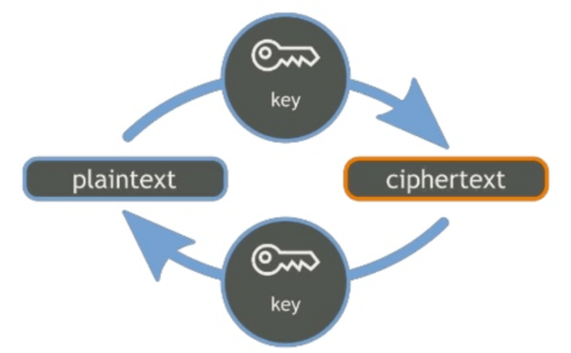
Process
Sign up
Log in
Caesar or Mono alphabetic?
Encryption or Decryption?
Default Key or Customize Key?

Slide 5
Sign-up & Log-in
Sign up
Information will automatically be saved in a text file, path of which will be the username
Username and password will also be saved
Log in

Slide 6
Caesar Encryption
Checks if the input is English alphabet
Adds each character’s ASCII value to the key
Prints encrypted text

Slide 7
Caesar Encryption Algorithm
Hi to all
3
Kl wr doo
if (ch >= 'a' && ch <= 'z') {
ch = ch + key;

Slide 8
Caesar Decryption
Checks if the input is English alphabet
Subtracts each character’s ASCII value by the key
Prints decrypted text

Slide 9
Caesar Decryption Algorithm
f (ch >= 'a' && ch <= 'z') {
ch = ch - key;
Kl wr doo
3
Hi to all

Slide 10
Monoalphabetic Encryption
Key: permutations of the letters in the English alphabet
replaces each plaintext letter by the letter in the permutation
English alphabets and key are valued from 0 to 25 using array
Prints encrypted text

Slide 11
Monoalphabetic Encryption Algorithm
if (pt[j] == p[i]) {
c[i] = ct[j];
}
kl zy aee
qwertyuiopasdfghjklzxcvbnm
hi to all

Slide 12
Monoalphabetic Decryption
Key: permutations of the letters in the English alphabet
replaces each encrypted text’s letter by the letter in the permutation
English alphabets and key are valued from 0 to 25 using array
Prints decrypted text

Slide 13
Monoalphabetic Decryption Algorithm
if (ct[j] == c[i]) {
r[i] = pt[j];
}
hi to all
qwertyuiopasdfghjklzxcvbnm
kl zy aee

Slide 14
Functions from C Library
Header Files
stdio.h
conio.h
ctype.h
string.h
fprintf,fscanf
gets,puts
getch
toupper
strlen
strcmp
printf,scanf

Slide 15
Function Defined & Declared By Members
void Casear_Cryptography ()
void Caeser_Encryption_CK (int n)
void Caeser_Decryption_DK (int n)
void Caeser_Encryption_DK (int n)
void Caeser_Decryption_CK (int n)

Slide 16
Function Defined & Declared By Members
void Monoalpha_Cryptography ()
void monoalpha_decryption ()
void monoalpha_encryption ()
void Monoalpha_Encryption_DK ()
void Monoalpha_Decryption_DK ()
void Monoalpha_Decryption_CK ()
void Monoalpha_Encryption_CK ()

Slide 17
Final Report
Sadia Ahmed Bushra
Caesar Customize Key
Power point presentation
Md. Mehedi Hasan
Caesar Default Key
Debug
Apon Ghosh
Combining everyone’s task
Combining the program
Monoalphabetic Default key & Customize Key
Debug
Farjahan Akter Boby
Switch Cases
Sign-up, Log-in
Razaan Reza
Proposal
Report

Slide 18

Have any questions?

Slide 19

Thank You

